Slide 1
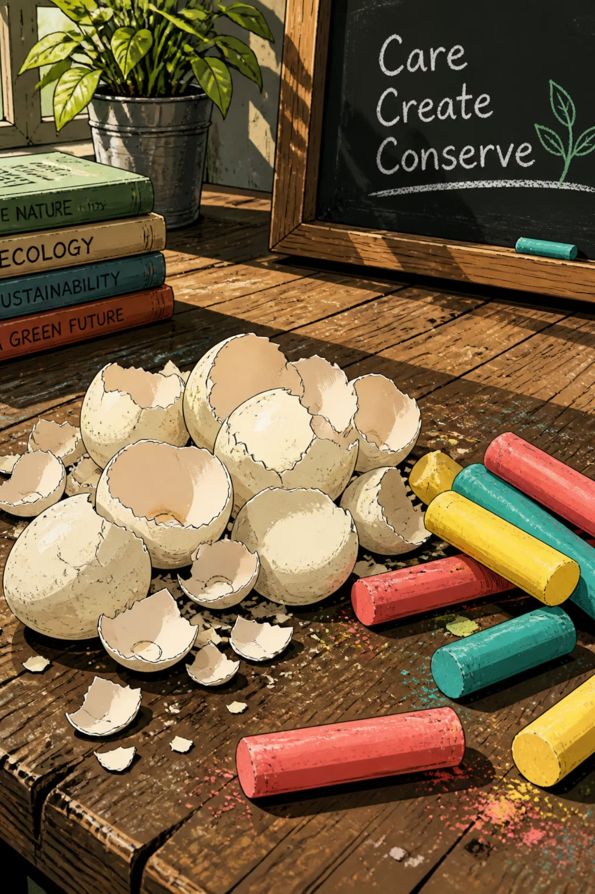
EcoChalk: Sustainable Chalk Production from Eggshell Waste
"Transforming Kitchen Waste into Eco-Friendly Classroom Solutions."
Project Type
Eco-Friendly Product from Waste
Academic Year
2026–2027

Slide 2
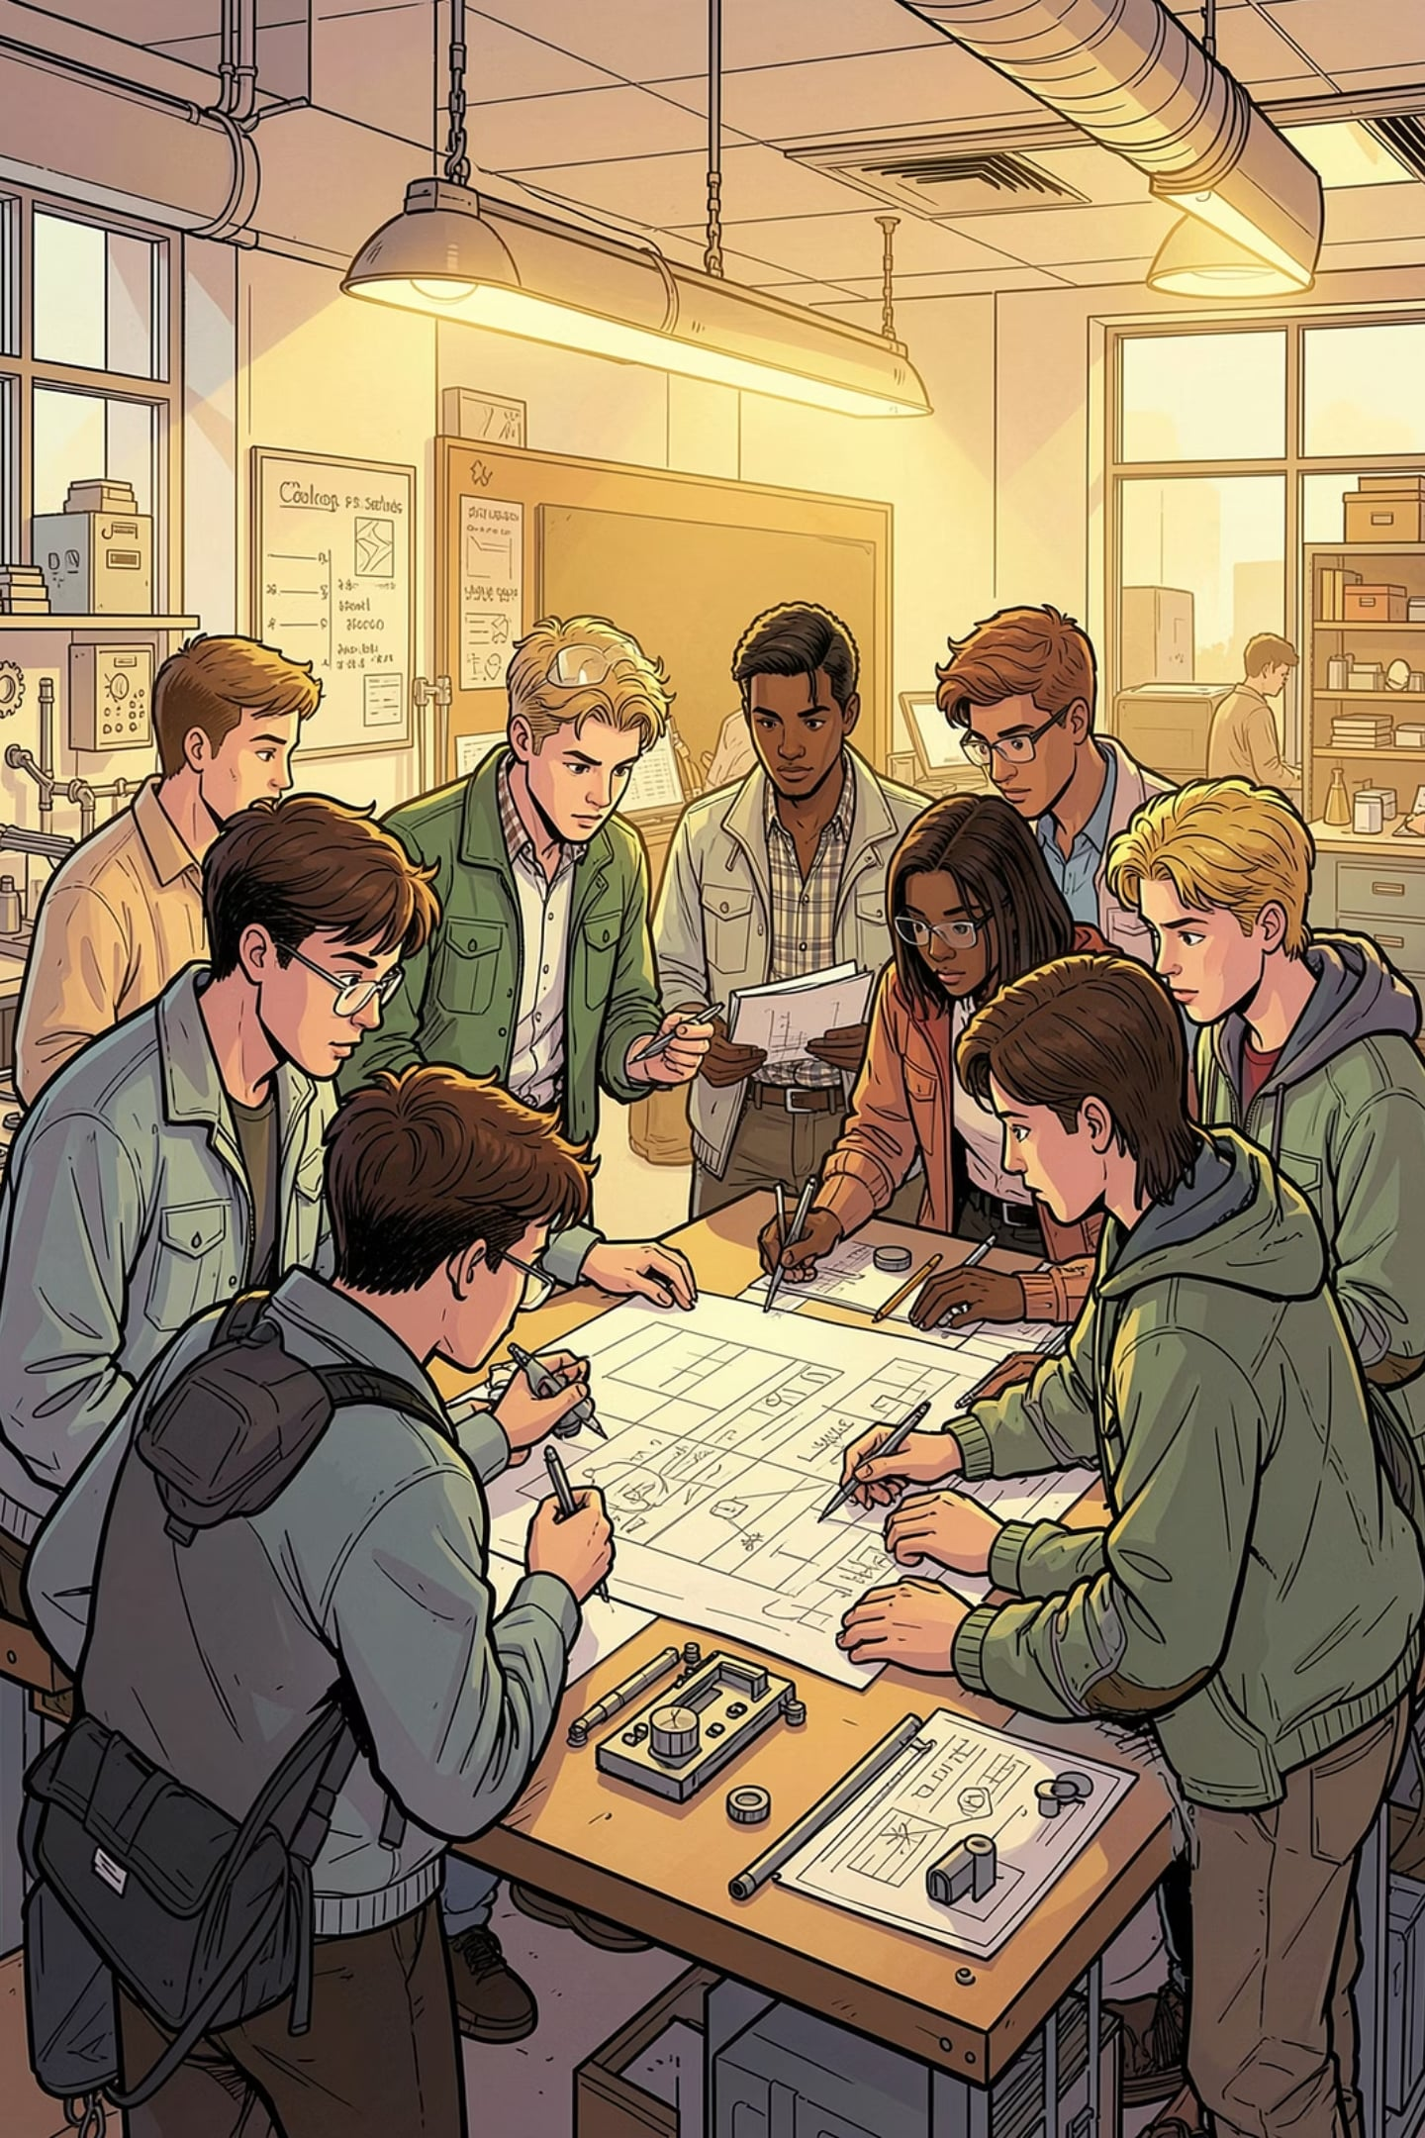
Team Members
Sneha Buchade
Aditi Pise
Sanika Pingale
Anju Koli
Priya Khade
Swalehin Shaikh
Guide
Department
Mrs. Rekha Kamble
CSE - AIML

Slide 3
Objectives of the Project
Convert discarded eggshells into eco-friendly chalk.
Reduce kitchen waste and promote recycling.
Develop a low-cost and non-toxic alternative to conventional chalk.
Minimize environmental pollution caused by waste disposal.
Encourage sustainable practices in educational institutions.
Demonstrate the concept of "Waste to Wealth."

Slide 4
Why This Project?
Problem
Need
Large quantities of eggshells are discarded daily by homes, restaurants, and bakeries.
Eggshell waste usually ends up in landfills, causing unnecessary waste accumulation.
Conventional chalk production requires mining of natural minerals such as limestone and gypsum.
Reuse biodegradable waste effectively.
Reduce dependence on natural resources.
Promote eco-friendly products in schools and colleges.
Support sustainable development and circular economy practices.

Slide 5
Methodology
01
02
Step 1
Step 2
Collect eggshell waste from homes, hotels, or bakeries.
Wash thoroughly to remove impurities.
03
04
Step 3
Step 4
Dry the eggshells completely.
Grind the shells into a fine powder.
05
06
Step 5
Step 6
Mix the powder with a natural binder (such as cornstarch or flour paste) and water to form a smooth paste.
Pour the mixture into chalk molds.
07
08
Step 7
Step 8
Allow the chalk to dry for 24–48 hours.
Test the chalk for writing quality, strength, and durability.

Slide 6
Expected Results
Production of strong and smooth eco-friendly chalk.
Effective utilization of eggshell waste.
Reduction in organic waste disposal.
Affordable chalk suitable for classrooms.
Increased awareness about recycling and sustainability.
A simple manufacturing process that can be adopted by schools or small-scale industries.

Slide 7
Conclusion
Eggshell waste can be successfully converted into useful classroom chalk.
The project demonstrates an innovative and sustainable approach to waste management.
It promotes environmental conservation through recycling.
The product is economical, biodegradable, and safe for educational use.
This initiative supports the Reduce, Reuse, and Recycle (3R) principle and contributes to a cleaner, greener future.

Slide 8
Thank You!

